Slide 1
Introduction / Thinking Like a Computer
Day One of Programming Workshop
Andie Creel (she/her)
January 2024

Slide 2
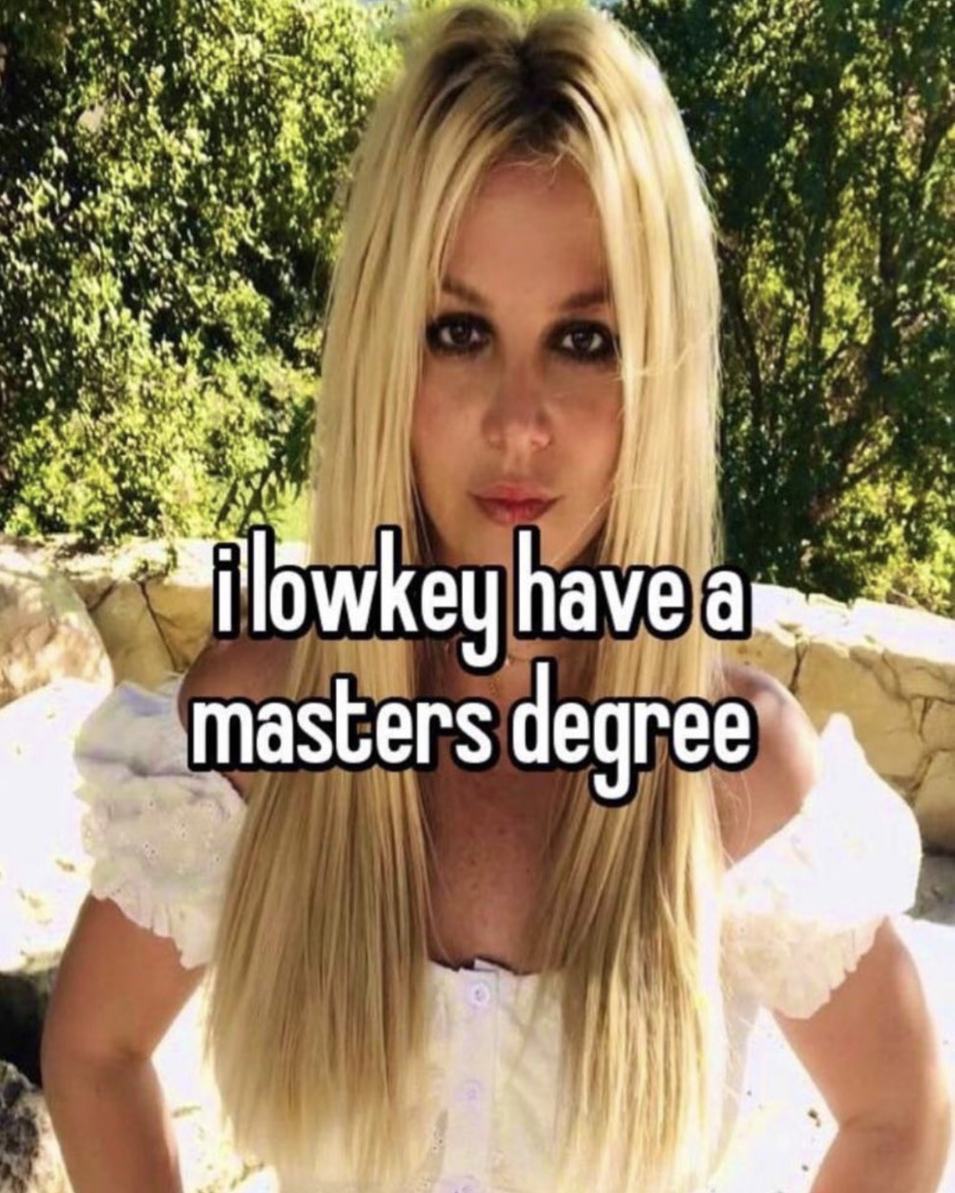
My background
Freshman in college: financial engineering (whatever that is) -> Java
“I am a magician”
Majored in Econ, minored in CS
TAed programming labs in college
Pandemic Hobby: big data
Master’s thesis: Parks use in pandemic (Cell Phone Data)
Dissertation work: Environmental Econ -- value of local recreation and urban green space

Slide 3
My motivation for knowing how to program
Sustainable development: "meets the needs of the present without compromising the ability of future generations to meet their own needs” -- Brundtland Report, 1987
Needs: consumption of goods, health, political stability, culture
The environment and natural resources affect all these needs
That affect can be hard to observe/measure
Explosion of data and computing power can help us observe and understand how nature affect sustainable development
“What gets measured gets managed” – Peter Drucker (maybe?)
Notes:
Brundtland report is when the world realized GDP wasn’t a good indicator of progresses and welfare when used on its own

Slide 4
Introductions
Name (pronouns)
What you do at YSE
Why you decided to take this workshop

Slide 5
Outline for next 3 days
9:30am to ~noon
Two 60 to 80-minute lectures per day
30 min break between
A mini problem set every day
Not graded
I will release my code at 8pm
Office hours
Location: 301 prospect St, room 101
Time: 2 – 5 pm
Come to OH (even if you don’t know how to ask your question)!
Today
Thinking Like a Computer (pseudo code)
Base R
Introduction to packages
Tomorrow – tidyverse packages
Data manipulation (dplyr, tidyr)
Data visualization (ggplot2)
Friday
Wrap up tidyverse, if needed
Programming is Programming (python)
Collaboration and Version Control (GitHub)

Slide 6
Thinking Like A Computer
Skills to help you outline and (eventually) debug code
Thanks to Ethan Addicott and Matt Gordon for early iterations of this lecture

Slide 7
What is programming
Bits and bytes – what the computer actually speaks (0s and 1s)
Machine and Assembly languages – idk what this really is, but pretty sure it translates our code to 0s and 1s
Programming languages – R, Python, C, Java
Software – Windows, iOS, Applications, Excel, R Studio

Slide 8
What is programming
Bits and bytes – what the computer actually speaks (0s and 1s)
Machine and Assembly languages – idk what this really is, but think it translates code we write to 0s and 1s
Coding languages – R, Python, C, Java
Software – Windows, iOS, Applications, Excel, R Studio
Notes:
This workshop is focused on coding with programming languages
We’ve all used software
Very few of us will use machine and assembly languages (I don’t)
To program and code successfully you need to know how to think like a computer

Slide 9
Some language
Code
What your computer runs
Many languages – R, Python, Java, HTML and CSS, command line
Script: The text file where you write your code
Comments
Notes you write yourself that the computer doesn’t read
SO IMPORTANT!
Run (aka compile and execute): when the computer executes your code
IDE/GUI/Software
Where you write and run your scripts and comments
R Studio, Google Collab (Collaboratory)
Notes:
IDE: integrated development environment

Slide 10
Think like a computer: more than coding
Programming is defining and solving problems
Require creativity
Clear definition of “problems”
Cannot solve a problem that isn’t defined (how do you know its solved?)
Forces precision and accuracy in problem definition
Collaboration: Once clear to you, can also be clear to team members
Solutions to big “problems”
Our field is filled with giant problems
To make progress, need to break them into solvable pieces
Leaning to program is learning how to break big problems down
Steps are clear
Notes:
Lets back out
Why is it important to think like a computer (more than coding)

Slide 11
Think like a computer: coding
Efficiency and Speed – its so much faster
Accurate – not reliant on copy-paste/find-replace
Replicability – for your teams, others, new datasets
Customize – write models for your data, clean and manipulate data for your models
Employment – more jobs, better jobs, more money
Collaboration – GitHub on last day
Notes:
Now lets zoom in, why is it worth learning how to code?
Varies wildly, but on average, people who code make 20-30% more which is something like 10-20k more per year

Slide 12
Pseudo Code – 1st step of thinking like computer
What
Pseudo code is the outline of your code
Similar to writing process
Not actually a coding language
I do it on scrap paper or in comments at the stop of script
Why
Clarifies your logic – are you actually solving the problem?
Serves as road map and plan – important for multiple work sessions
Collaboration/Documentation – can communicate what you did to others

Slide 13
Exercise One: Coffee
Write instructions for how to brew a cup of coffee (3 min)

Slide 14
Exercise One: Coffee
Switch instructions with a partner
Have them “run” your code
Do you find any bugs? (5 min)

Slide 15
Exercise two: Rock paper scissors
How do you play Rock, Paper, Scissors?
You will need multiple cases (5 min)

Slide 16
Exercise two: Rock paper scissors
Switch partner.
Play by the rules they just gave you.
Can you cheat??

Slide 17
Exercise two: my realistic pseudo code (lazy)
Player: choose rock paper scissor
Computer: random generate rock paper scissor
Compare P & C
If P = Rock
And C = Rock: tie
And C = paper: player loses
And C = scissors: player wins
Same for if P = paper and P = Scissors

Slide 18
Exercise two: not lazy
While play_again is true
Prompt the player to select Rock, Paper, or Scissors
Generate a random choice for the computer (Rock, Paper, or Scissors)
If player's choice is the same as computer's choice
Display "It's a tie!"
Else If player chooses Rock and computer chooses Scissors
Display "Player wins! Rock crushes Scissors."
Else If player chooses Paper and computer chooses Rock
Display "Player wins! Paper covers Rock."
Else If player chooses Scissors and computer chooses Paper
Display "Player wins! Scissors cut Paper."
Else
Display "Computer wins!"
Ask the player if they want to play again
set play_again to true or false
Notes:
This if else is very elegant

Slide 19
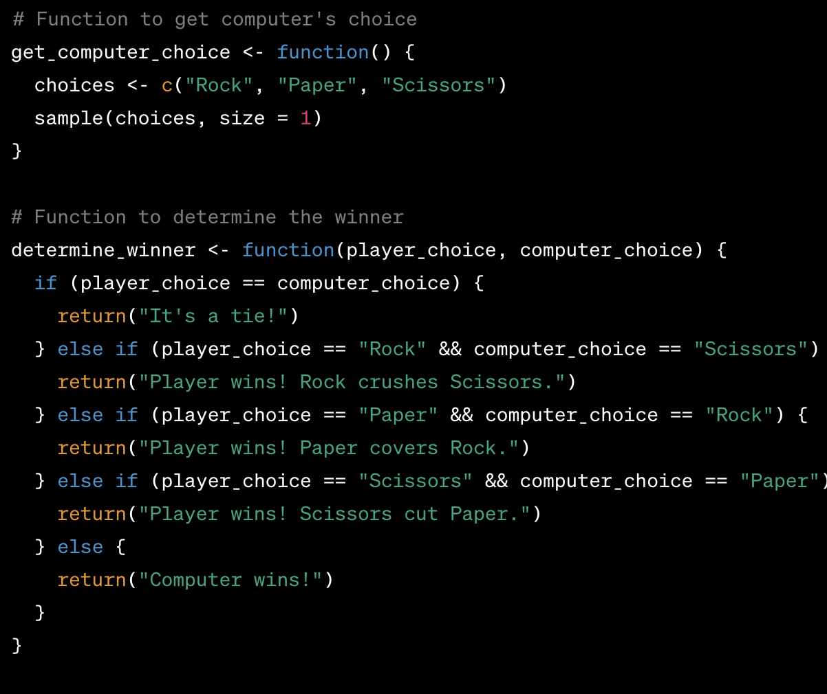
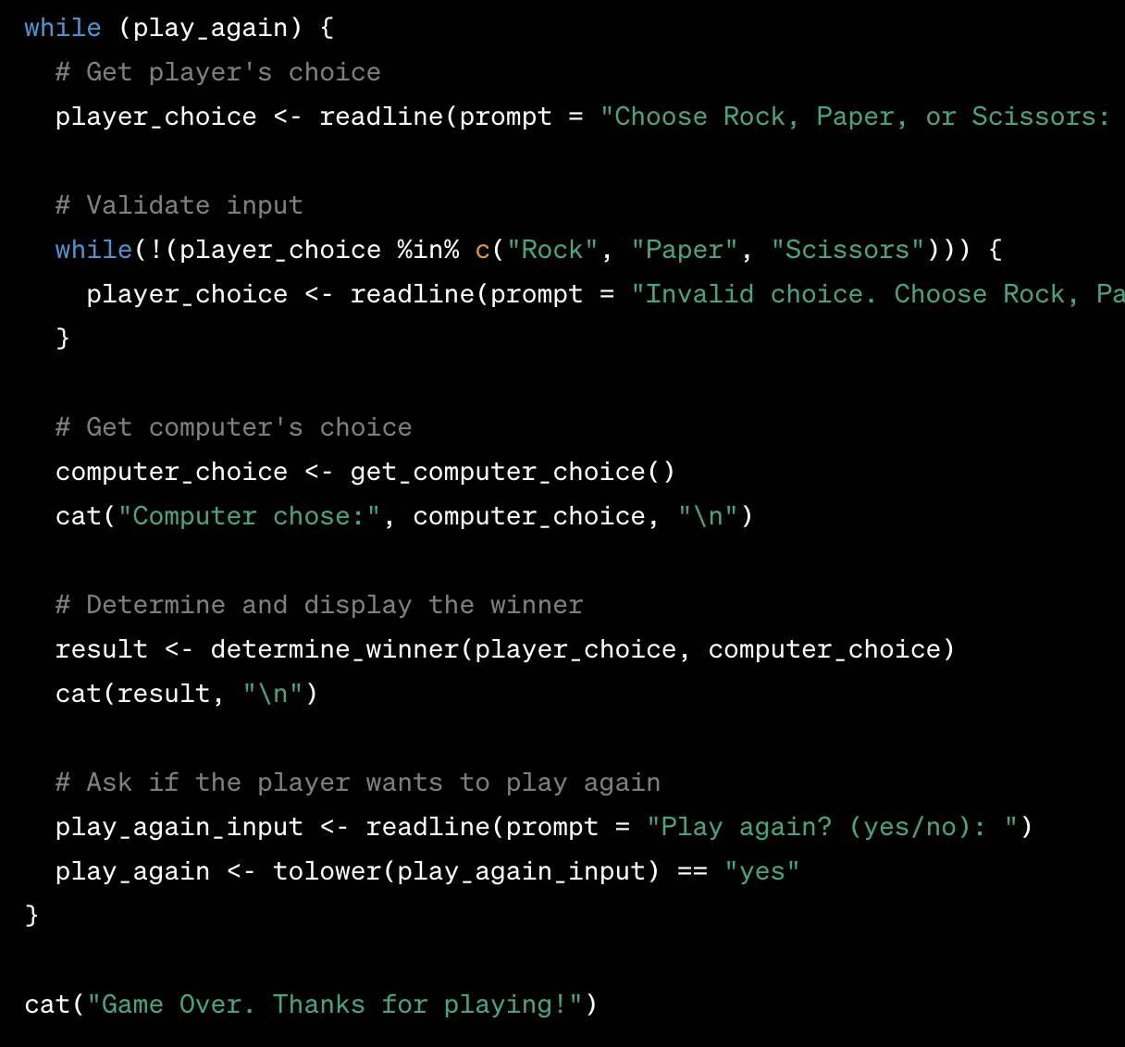
R Code
Notes:
If i told you the C choice and person choice, you should be tell what happens here
Things to highlight in this
Function
If_case cases
Boolean comparison
Loop
Storing a result

Slide 20
Couple of notes on writing, debugging code
“I minored in stack overflow”
I still have to look things up constantly
Knowing programming makes me better at:
Defining problems
Developing solution strategies
Solving harder and harder problem
Documentation, Google, Stack Overflow and ChatGPT can help you from there
But if you don’t know how to define and solve problems, you won’t be bale to take full advantage of these aids
Notes:
Youll see me constantly googling, looking up documentation and asking chat gpt questions
But to actually get anywhere, I need to be able to define the problem and a solution strategy
Like I said at beginning, knowing the basics of programming will help you know how to creat solution strategy bc youll have practiced

Slide 21
Couple of notes on writing, debugging code
“I minored in stack overflow”
I still have to look things up constantly
Knowing programming makes me better at:
Defining problems
Developing solution strategies
Solving harder and harder problem
Documentation, Google, Stack Overflow and ChatGPT can help you from there
But if you don’t know how to define and solve problems, you won’t be bale to take full advantage of these aids
Notes:
This is really what I want you to get outta this: define and solution strategy

Slide 22
ChatGPT and other AI tools
Any of them could solve 100% of what we do this week
But they can’t solve everything you’ll eventually want to do
You can’t get to the cutting-edge problems without basics
At the very least, you’ll be limited
Learn basics so that you can get to hard problems, and use AI as a collaborative aid once there

Slide 23
What’s next
30 min break
Base R

